Slide 1
CS 470 Project Two Conference Presentation: Cloud Development
Quinnie Ho
August 2023
Notes:
Hi everyone. My name is Quinnie Ho, and I’m a developer at QnA.

Slide 2
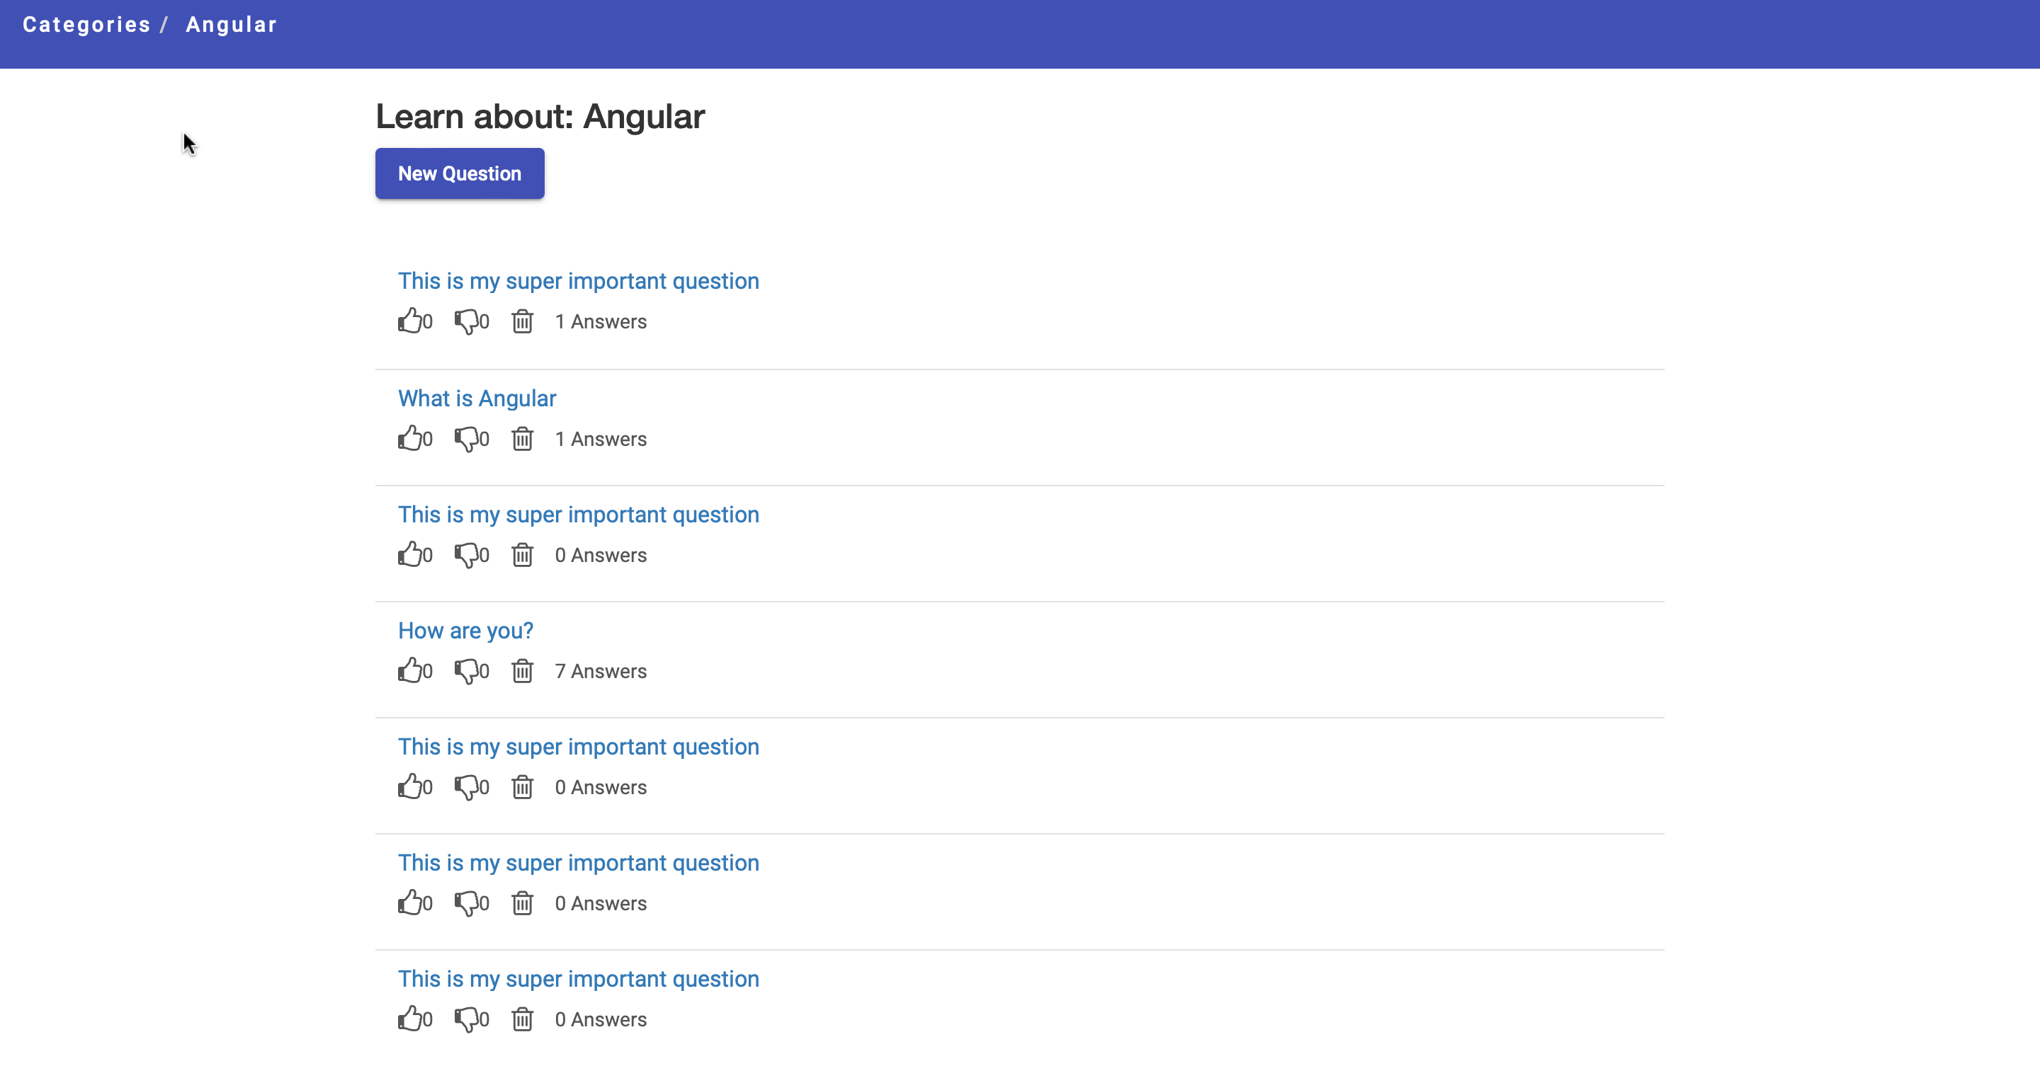
Overview
Introduction
Purpose of presentation: Process and advantages of migrating a full stack application to an AWS serverless solution
Notes:
My presentation today is on the process and advantages of migrating a full stack application to an AWS serverless solution. This process provided a fast, seamless, cost-effective, and secure way to deploy our application publicly. Moreover, this solution takes care of creating and managing the infrastructure required to run the application, so that we can just focus our efforts on development.
This screenshot here shows our frontend display of questions and answers. This page allows users to create, read, update, and delete questions and answers (also known as the CRUD operations). These actions are, then, synced back to our database on the backend.
Alright, so let’s dive in!

Slide 3
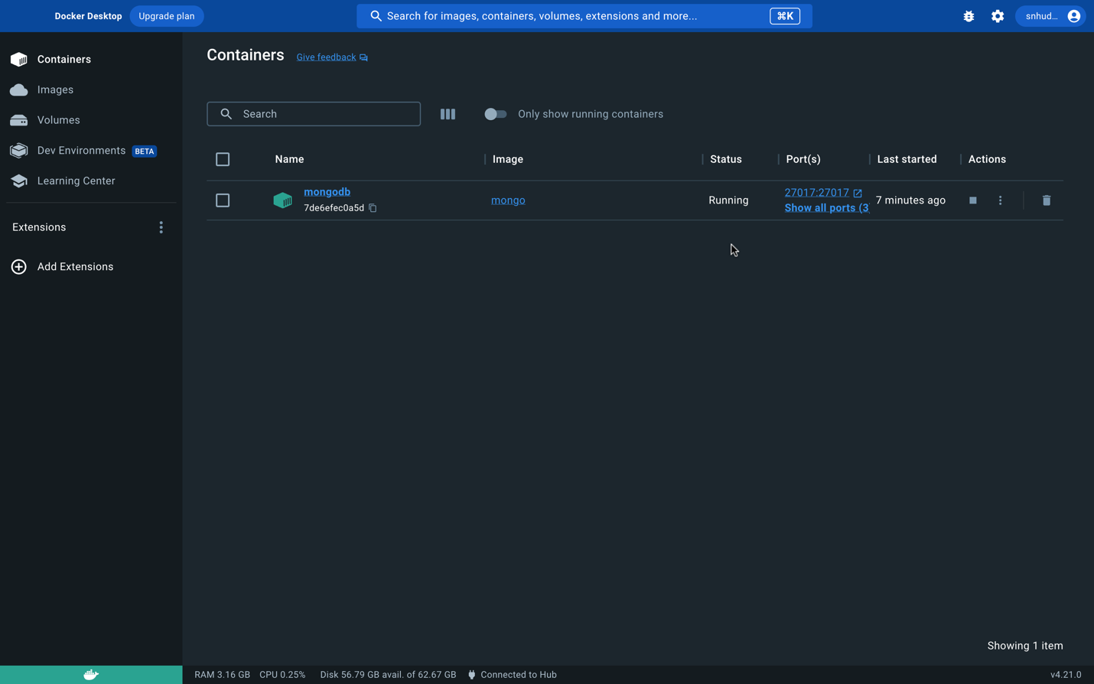
Containerization
Containerization and Lambda models were used to migrate a full stack application to the cloud
Docker as a tool for containerization
Notes:
There are several options to choose from when wanting to migrate a full stack application to the cloud. The two most popular models are containerization and Lambda. We utilized the AWS Lambda model for our migration, but I’ll touch base on the containerization model first. Containerization is the process of using images within containers to reliably run software that has been moved to a new computing environment. A container includes an application with dependencies, libraries, and configuration files that are all already wrapped up in one convenient package and ready to be used. This ensures that the software consistently runs as expected, regardless of the computing environment. Generally speaking, containerization is best used when developers want or need more control of an application’s hosting environment.
There are a variety of tools available for containerization, with the most popular being Docker. It’s lightweight, portable, fast, and cost effective. It’s also user-friendly and comes in a desktop version, as you can see in the screenshot here. This screen that we’re looking at shows a container named “mongodb” with details of its status.

Slide 4
Orchestration
Values of using Docker Compose:
Front and backend containers are consolidated, and then run and managed as one cohesive unit
High scalability with low management efforts
Dependencies are consolidated and requirements are set up on one file to make it easier to mirror a production environment during development
Creating a working full-stack application that can operate on any user’s system, regardless of the components that are installed on each system
Notes:
Container orchestration is a valuable part of the containerization model. It allows users to consolidate multiple containers, and then run and manage them as one cohesive unit. Docker Compose is a highly valued composition that has the ability to consolidate both frontend and backend containers. This tool makes it easier for developers to scale and manage an entire application stack in a more streamline manner. Docker Compose also allows developers to consolidate dependencies and set up requirements into one file that makes it easier to mirror a production environment during development. A big advantage of this is creating a working full-stack application that can operate on any user’s system, regardless of the components that are installed on each system.
Docker can easily be linked with your command-line interface, such as Terminal for MacOS or PowerShell for Windows. The screenshot shows a simple command to display a list with four containers that were created using Docker Compose.

Slide 5
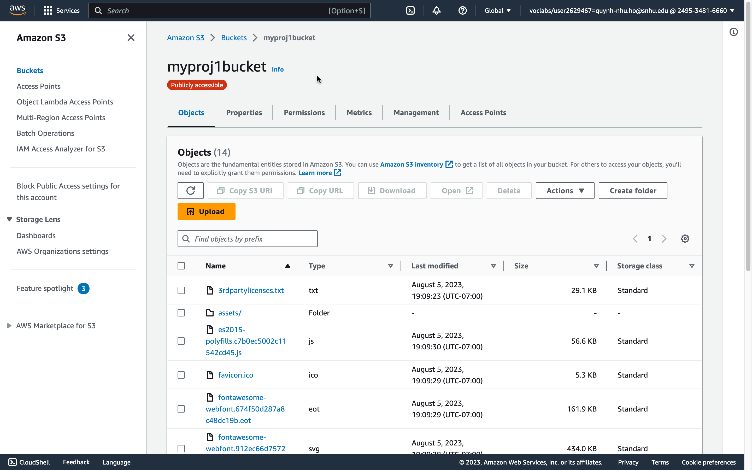
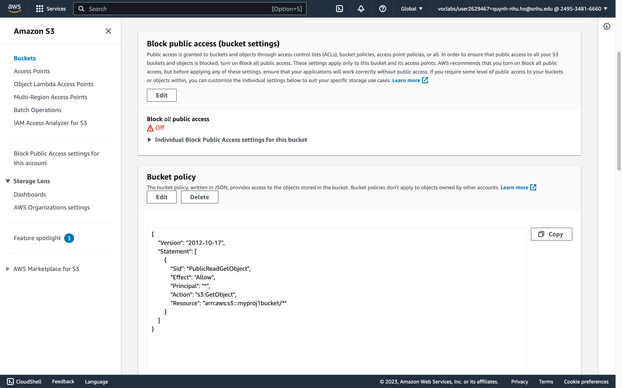
The Serverless Cloud
Serverless
“Serverless” cloud computing means that developers do not have to worry about managing a server. Advantages are:
Ability to run full-stack application on the cloud with no need to build or manage the infrastructure
Developers can focus more time on developing and maintaining their code
Pay-as-you-use service
Simple Storage Service (S3): A cloud-storage service provided by Amazon. When compared to local disc storage, it’s more:
Scalable
Mobile
Cost-effective
Notes:
Now, let’s talk about serverless cloud computing. Serverless means that developers do not have to worry about managing a server. It allows developers to run a full-stack application on the cloud with no need to spend extra money or time dealing with building and managing the infrastructure that enables the application to operate. This also gives developers more time to focus on developing and maintaining their code. Another advantage of serverless is the fact that it’s a pay-as-you-use service. This means that you only pay for the amount of resources that you use, such as storage.
We used AWS’ Simple Storage Service (S3) to handle our application’s cloud storage. It provides a much more scalable, mobile, and cost-effective way to store data compared to local disc storage. Personally, I find the durability aspect of S3 to be a unique feature, because it has 11 nines durability. This means that if 10,000 files are stored within S3, then a user can expect to lose, on average, one file every 10 million years…that’s incredible! Not to mention, files are stored across multiple facilities and on multiple devices within each facility. All-in-all, it has supreme durability when compared to local disc storage.
The screenshot here displays an overview of our application’s S3 bucket. More specifically, this page displays the ”Objects” page of the bucket. Enhanced security is another valuable aspect of S3. Buckets are private when they’re created, and there is a two-step process to make them public. The first step is to update the “block public access” settings to grant access to your bucket. We can see in this screenshot here (and here specifically) that the setting for the “block public access” is off, which means that the bucket is public. Then, you must add a bucket policy to grant and specify access to the operations that can be performed on your bucket. The policy on this screen here shows an access to get objects in this bucket.

Slide 6
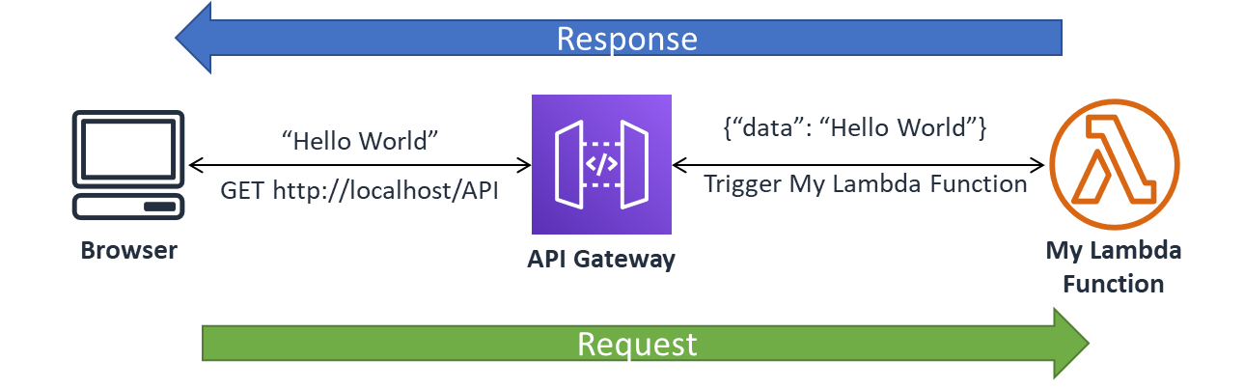
The Serverless Cloud
API & Lambda
Advantages of using a serverless API:
Ease of creating an API and getting started with making your application live
No new tools you must learn and be familiar with first before getting started
One-stop shop for creating methods and configurations for APIs, testing them, deploying them, and then managing and monitoring the results
AWS Lambda API logic = Mapping created Lambda functions to serverless API using methods, resources, and configurations
Scripts required:
Code to create Lambda functions
Creation of serverless API
Creation of method and resources within API that map to specified Lambda functions
Cross-Origin Resource Sharing (CORS) configuration to use HTTP headers and allow resource sharing across different domains
API deployment
Steps needed to integrate the frontend with the backend:
Update the backend code with the API URL
Create new public S3 bucket or update existing one with required application files uploaded
Configure bucket as a website
Resource: SNHU
Notes:
Now, let’s dive deeper into the AWS Lamba model that we introduced earlier. Lambda is a compute model that handles administrative work to ensure that an application’s backend and infrastructure operates smoothly.
One big advantage of using AWS Lambda is the Lambda API logic. This is the ability to create functions, and then simply wire them to AWS’ serverless API, known as Amazon API Gateway. Some advantages of using a serverless API are:
The ease of creating an API and getting started with making an application or code live.
No new tools that you must learn and be familiar with first before getting started.
A one-stop shop for creating methods and configurations for APIs, testing them, deploying them, and then managing and monitoring the results. This is a very convenient and scalable way to create and deploy REST APIs to run your application quickly and effortlessly, without having to handle a lot of the backend API heavy-lifting work.
The scripts that were produced to make the Lambda API logic work for our application are:
Code to create Lambda functions
Creation of the serverless API
Creation of method and resources within the API that map to specified Lambda functions
Cross-Origin Resource Sharing (CORS) configuration to use HTTP headers and allow resource sharing across different domains. This is done by creating OPTIONS methods within each resource branch.
Deployment of API
The frontend URL for your application is given once the API is deployed. The backend code needs to be updated with this URL to integrate the frontend with the backend. The steps towards integration are:
Update the backend code with the API URL.
Create a new public S3 bucket or update an existing one with required application files uploaded, as mentioned in the previous S3 slide.
Configure the bucket as a website. A URL for the endpoint is generated once this step is complete.
This diagram is a good, straightforward depiction of how the Lambda and API logic work. As you can see, the API acts as a gateway between the requests and responses between the browsers and Lambda functions. Another integral part of this serverless full-stack application is the database, so let’s dive into that piece now.

Slide 7
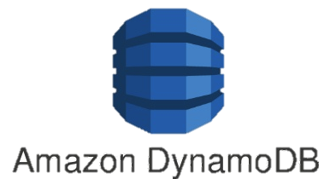
The Serverless Cloud
Database
JSON-based document storage in MongoDB vs. key-value storage in DynamoDB
Queries performed on our database:
Table scan
Get a record
Delete a record
Find a question from the ”Question” table
Upserting an answer into the “Answer” table
Upserting a question into the “Question” table
Scripts that are produced to make the queries possible are:
Creation of “Question” and “Answer” tables in DynamoDB with partition key of “id” and type of “string”
Data added to each of the two tables
Creation of Lambda function for each query
Lambda source code for each query
Lambda deployment
Security policy configuration for each Lambda function
Resource: SNHU
Notes:
MongoDB and DynamoDB are amongst the two most popular NoSQL databases used for full-stack development today. The data-model difference between the two is that MongoDB uses JSON-based document storage that can utilize BSON types while DynamoDB uses key-value storage that can support JSON types.
A total of six queries were performed on our database. They are:
Table scan
Get a record
Delete a record
Find a question from the ”Question” table
Upserting (update if it exists or insert if it doesn’t) an answer into the “Answer” table
Upserting a question into the “Question” table
The scripts that are produced to make the queries possible are:
Creation of “Question” and “Answer” tables in DynamoDB
Data added to each of the two tables
Creation of Lambda functions
Lambda source code for each query
Lambda deployments
Security policy configuration for each Lambda function
The image here is an extension of the one from the previous slide to depict the relationship between DynamoDB and Lambda, as well as show where it stands in the overall full-stack structure. When a user makes a request, it triggers a request in API. This wires up Lambda, and then the Lambda function queries the data stored in DynamoDB. Once the data is retrieved, the system works in reverse order by sending the response from DynamoDB to the user in the frontend.

Slide 8
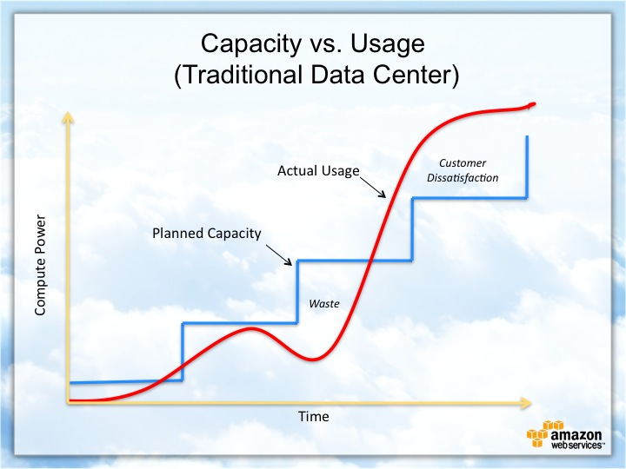
Cloud-Based Development Principles
Elasticity: Obtain resources on a per need basis, and then release them when no longer required
Pay-for-use model: Pay only for resources and usages that are consumed
Notes:
There are two value-added principles in cloud-based development, elasticity and the pay-for-use model. Elasticity is the idea that you obtain resources as you need them, and then release them when you are done using them. AWS Lambda is built upon elasticity and automatic scaling. This means that it only runs your code when necessary, such as responding to a request. This structure becomes cost-effective when coupled with the pay-for-use model. This model allows users to pay only for the resources and usages that they need. Not only is this model cost-effective, but it also ensures that resources are not going to waste.
This graph provides a visual idea of how a traditional data center’s capacity versus usage differs to that of the pay-for-use model. The x-axis indicates time and the y-axis indicates compute power. We can see the waste by the delta (or white space) between the blue planned capacity line and red actual usage line. More importantly, the graph gives us a good prediction that as time progresses, waste also increases. This, naturally, leads to an increase in customer dissatisfaction, because they’re wasting money on resources that are not being utilized.

Slide 9
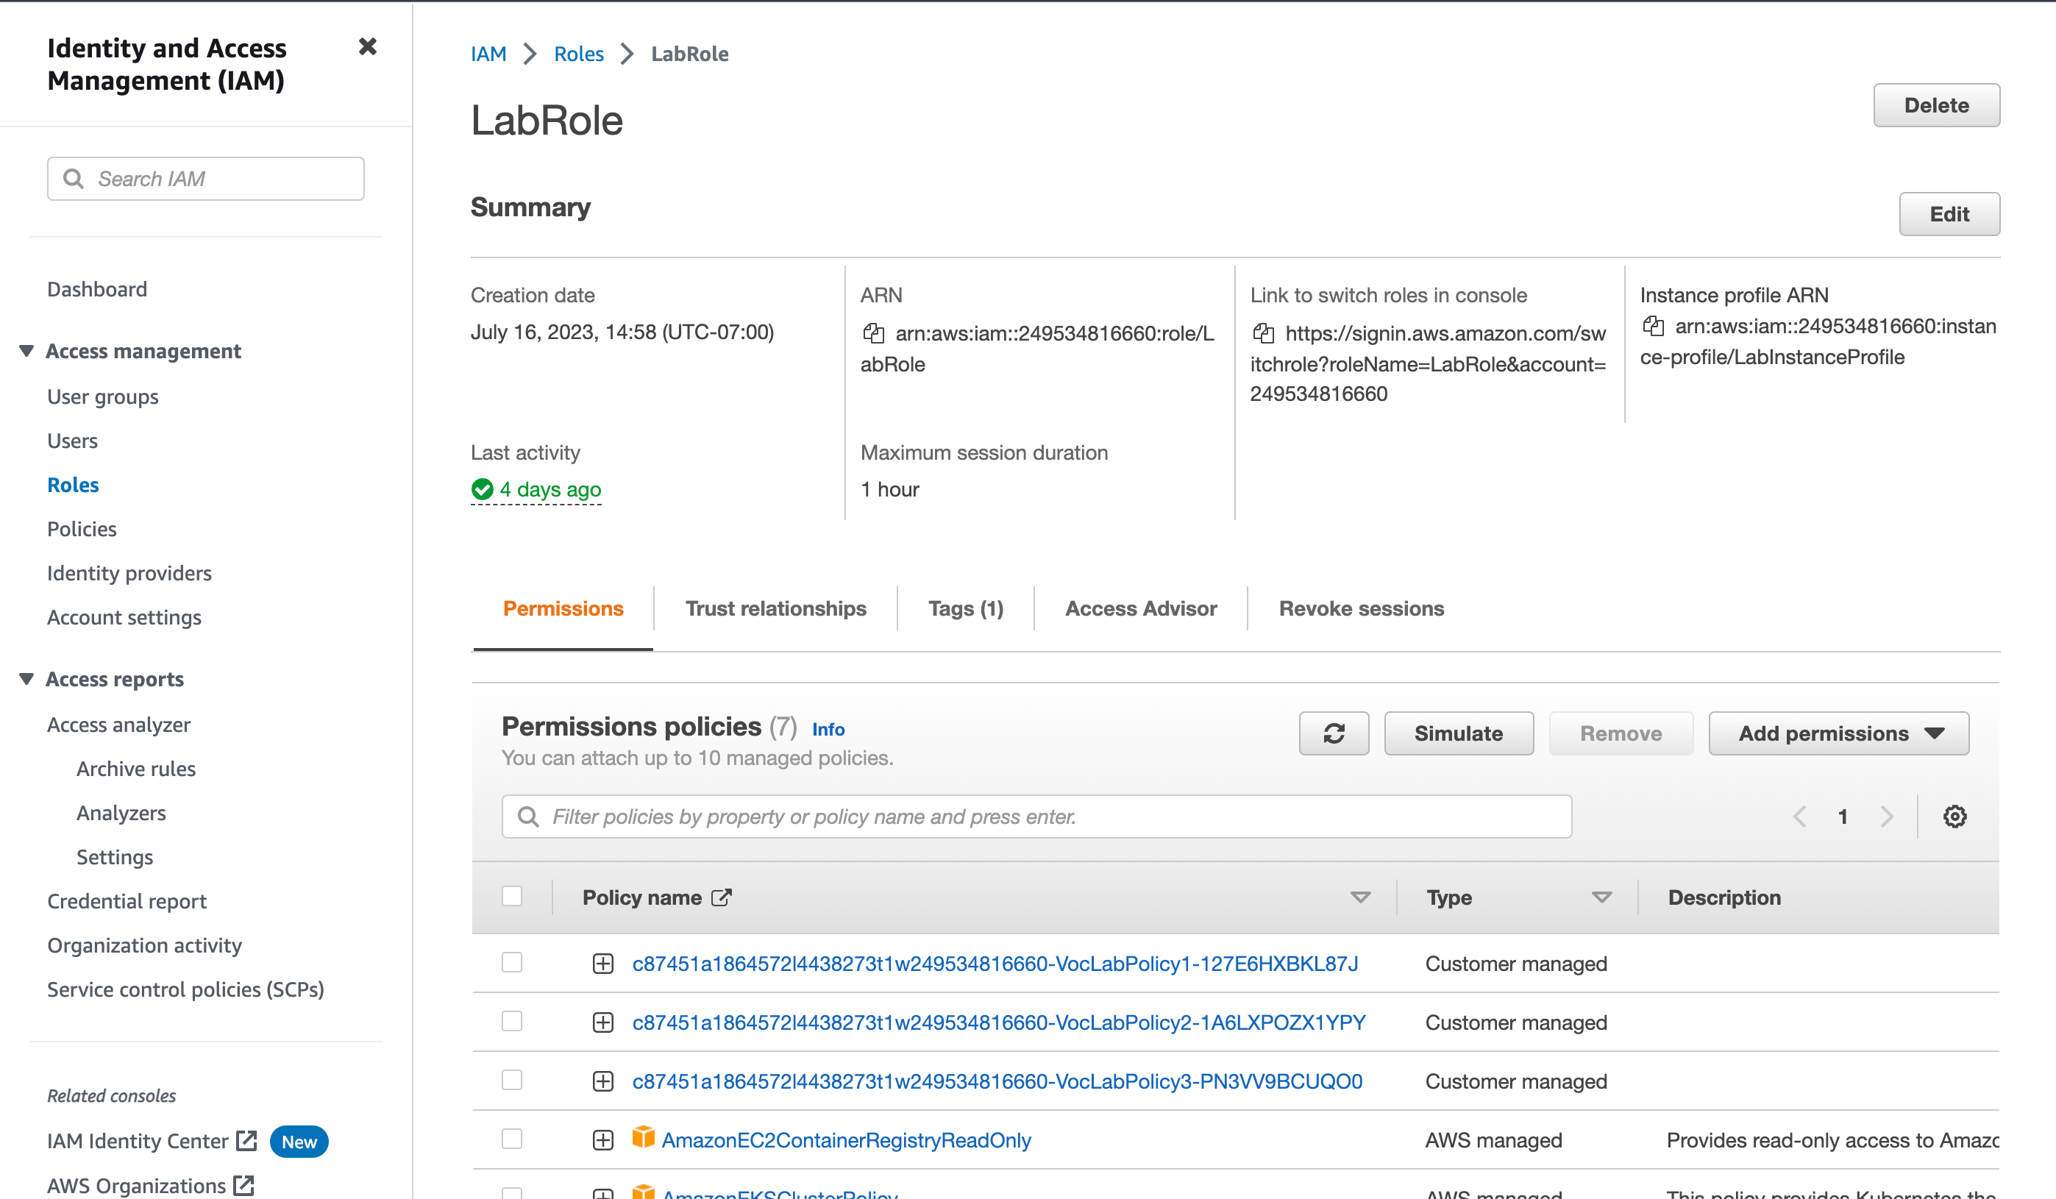
Securing Your Cloud App
Access
Policies
API Security
Unauthorized access can be prevented by specifying roles, policies, and permissions for each AWS service using Identity and Access Management (IAM)
Policies are created for specified roles
Custom policy to grant Lambda access to query from the “Question” and “Answer” tables in DynamoDB
Secure connection between Lambda and Gateway by adding permissions
Secure connection between Lambda and DynamoDB by creating policies within authorized roles
Secure connection between Lambda and S3 buckets by a two-step process to manually make it public and specifying a bucket policy
Notes:
Now, let’s address security - another big advantage of migrating your application to an AWS serverless solution. There are a variety of ways that AWS helps to prevent unauthorized access to your application, and it’s all package neatly in their Identity and Access Management (IAM) service. This service allows users to specify security protocols around the AWS computing, storage, database, and application services. This is done by specifying roles, policies, and permissions for each service.
The relationship between roles and policies is that you can create policies to specify the type of actions and resources that can be performed and accessed based on a specified service, which are all tied to specific roles. For example, we created a policy that allows Lambda access to the “Question” and “Answer” tables in DynamoDB. The policy allows for specified actions such as reading table scans and queries. This policy is linked to a user role titled “LabRole” for added security. This means that any AWS account not assigned to “LabRole” does not have the authority to perform the actions linked to that role. This ability to create extra layers of security through roles and policies ensures that security is uphold by the principle of least privilege, which is based on a need-to-know or need-to-perform structure. You can see the main page of the “LabRole” in the screenshot here, and the list of policies that are created and linked to it. All of this is within the IAM service.
There are different ways you can enhance security when connecting Lambda with other AWS services. You can secure the connection between Lambda and API Gateway by adding permissions that authorize certain actions to be executed on your Lambda, such as a GET method to handle an HTTP request. Lambda and DynamoDB can be secured by creating policies within authorized roles, as mentioned previously. Finally, Lambda and S3 storage buckets can be secured by manually setting the bucket to public through a two-step process and specifying a bucket policy.

Slide 10
Conclusion
Three advantages of using the AWS serverless solution are:
A one-stop shop for getting your application live quickly without the need to deal with the system’s infrastructure
Pay-for-use model makes this a very cost-effective way to run your application
The IAM security service with the foundational principle of least privilege
Thank you for your time!
Notes:
In conclusion, the three most important advantages of using the AWS serverless solution are:
It provides a one-stop shop for getting your application live quickly without the need to deal with the system’s infrastructure. This allows you to focus more of your time and efforts on code development.
The pay-for-use model makes this a very cost-effective way to run your application, especially when it has elasticity and automatic scalability built into its services.
The IAM security service with the foundational principle of least privilege ensures enhanced security across all services through a multi-level approach using roles, permissions, and policies.
We recommend AWS serverless solution if you categorize the above advantages as the top three most important factors in your full-stack migration to cloud computing. We hope you enjoyed this presentation. Thank you for your time!

